Slide 1

The Waves
video | Transverse | Longitudinal | types | Home
Waves are the rhythmic undulations of water that roll across oceans, lakes, and rivers, driven by wind, gravitational forces, and the movement of the Earth. Each wave tells a story, from the gentle lapping of shorelines to the powerful crashes of storm-driven swells. They shape coastlines, create habitats for marine life, and evoke a sense of tranquility and adventure in those who witness their beauty. Whether surfed, admired, or studied, waves are a mesmerizing reminder of nature’s dynamic energy.

Slide 2
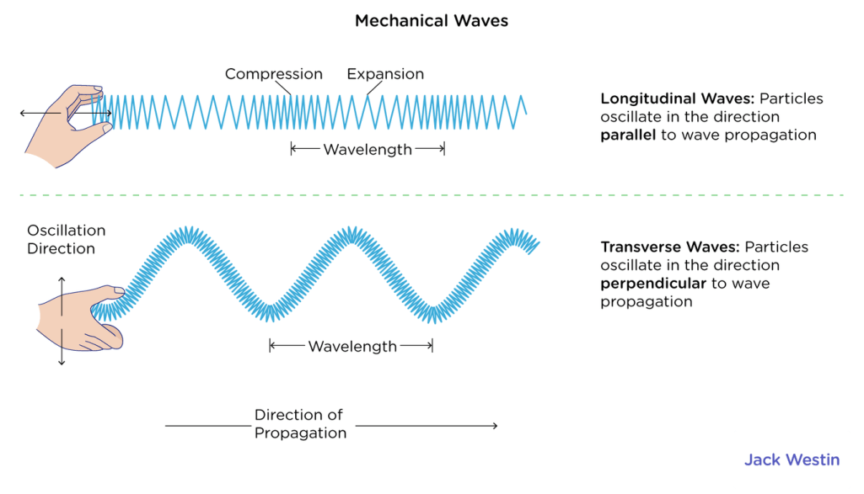
Types of waves

Slide 3
Longitudinal wave
Longitudinal waves are waves in which the vibration of the medium is parallel to the direction the wave travels and displacement of the medium is in the same (or opposite) direction of the wave propagation. Mechanical longitudinal waves are also called compressional or compression waves, because they produce compression and rarefaction when travelling through a medium, and pressure waves, because they produce increases and decreases in pressure. A wave along the length of a stretched Slinky toy, where the distance between coils increases and decreases, is a good visualization. Real-world examples include sound waves (vibrations in pressure, a particle of displacement, and particle velocity propagated in an elastic medium) and seismic P-waves (created by earthquakes and explosions).
The other main type of wave is the transverse wave, in which the displacements of the medium are at right angles to the direction of propagation. Transverse waves, for instance, describe some bulk sound waves in solid materials (but not in fluids); these are also called "shear waves" to differentiate them from the (longitudinal) pressure waves that these materials also support.

Slide 4
Transverse wave
In physics, a transverse wave is a wave that oscillates perpendicularly to the direction of the wave's advance. In contrast, a longitudinal wave travels in the direction of its oscillations. All waves move energy from place to place without transporting the matter in the transmission medium if there is one. Electromagnetic waves are transverse without requiring a medium. The designation “transverse” indicates the direction of the wave is perpendicular to the displacement of the particles of the medium through which it passes, or in the case of EM waves, the oscillation is perpendicular to the direction of the wave.
A simple example is given by the waves that can be created on a horizontal length of string by anchoring one end and moving the other end up and down. Another example is the waves that are created on the membrane of a drum. The waves propagate in directions that are parallel to the membrane plane, but each point in the membrane itself gets displaced up and down, perpendicular to that plane. Light is another example of a transverse wave, where the oscillations are the electric and magnetic fields, which point at right angles to the ideal light rays that describe the direction of propagation.

Slide 5
Longitudinal waves are waves in which the vibration of the medium is parallel to the direction the wave travels and displacement of the medium is in the same (or opposite) direction of the wave propagation. Mechanical longitudinal waves are also called compressional or compression waves, because they produce compression and rarefaction when travelling through a medium, and pressure waves, because they produce increases and decreases in pressure. A wave along the length of a stretched Slinky toy, where the distance between coils increases and decreases, is a good visualization. Real-world examples include sound waves (vibrations in pressure, a particle of displacement, and particle velocity propagated in an elastic medium) and seismic P-waves (created by earthquakes and explosions). | Longitudinal wave
In physics, a transverse wave is a wave that oscillates perpendicularly to the direction of the wave's advance. In contrast, a longitudinal wave travels in the direction of its oscillations. All waves move energy from place to place without transporting the matter in the transmission medium if there is one. Electromagnetic waves are transverse without requiring a medium. The designation “transverse” indicates the direction of the wave is perpendicular to the displacement of the particles of the medium through which it passes, or in the case of EM waves, the oscillation is perpendicular to the direction of the wave. | Transverse wave

